Slide 1

Project History
July 2007 Requirements & Design
April 2008 V 1.0 First instrument support
Feb 2010 V1.1 Collaboration with SNS & HFIR & Support multiple techniques
Jan 2012 V2.0
Scientist validated results. VATES integration
May 2015 V3.4 Improved functionality and usability … Development Continues

Slide 2







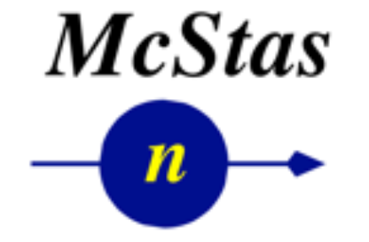
Contributors
Partners
Prime Contractor
Contributors

Slide 3
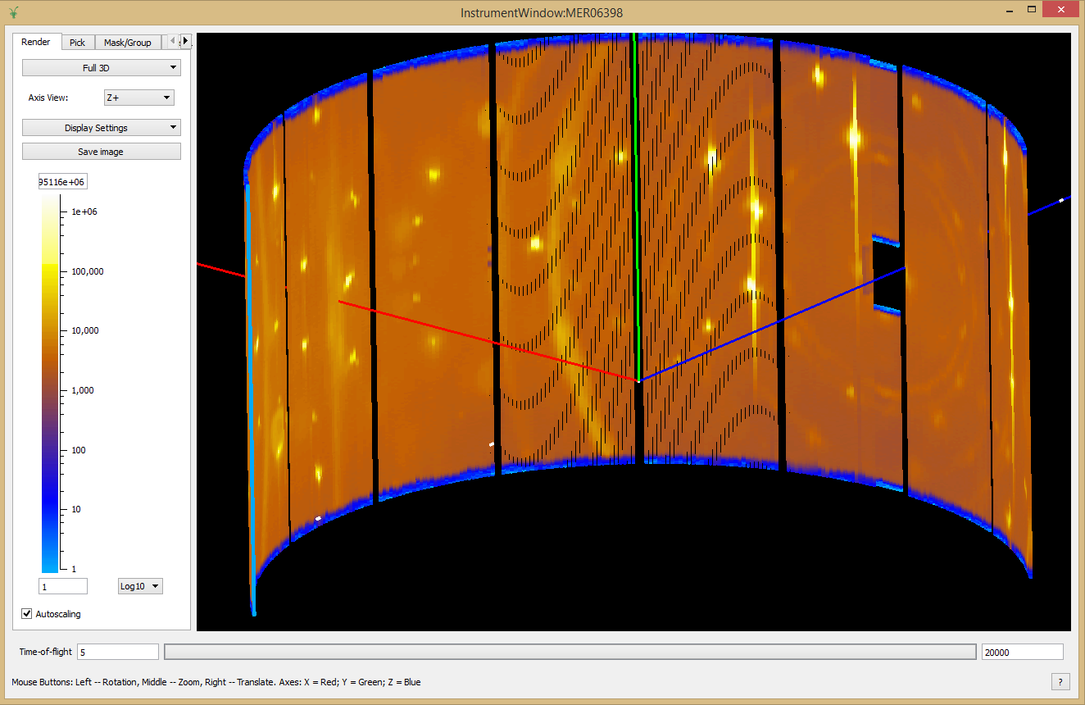
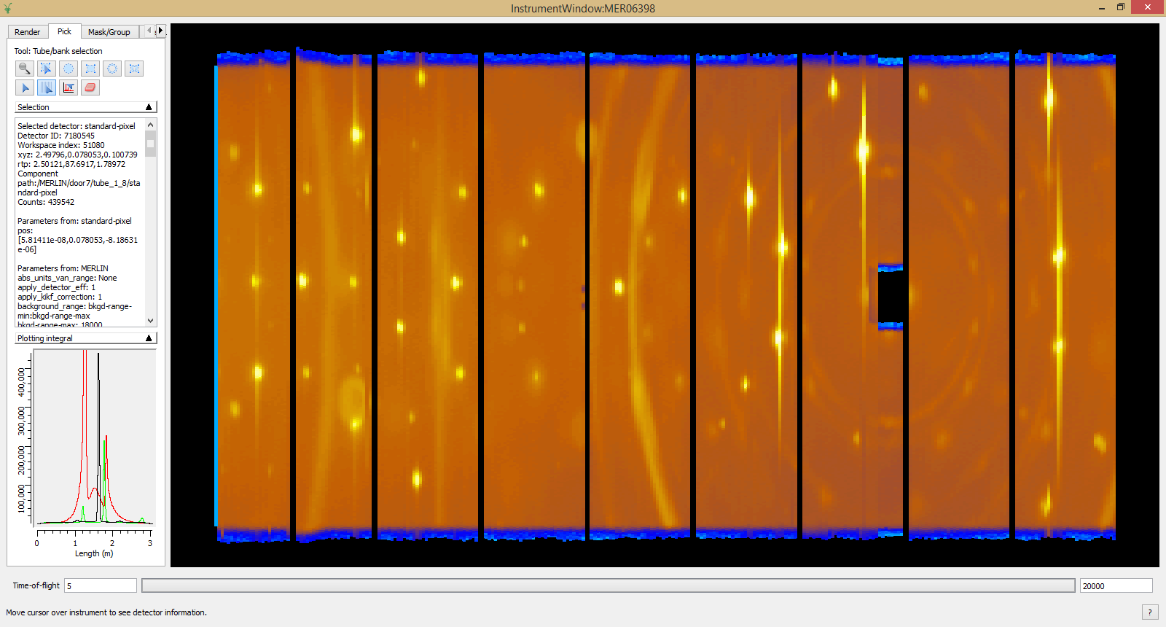
Instrument View
Unwrapped 2D View
3D View

Slide 4
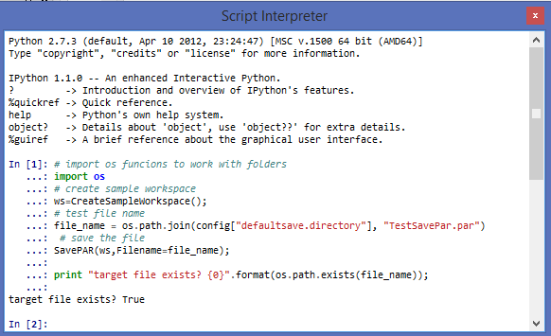
Scripting
Interactive via iPython
Scripts using the script window
Can also be controlled direct from Python without a user interface

Slide 5




Professional Development
Professional Project Management
Dedicated software engineers
All with science BSc, many with PhD
Source code control in Github
Continuous build and testing
20+ build servers managed through Jenkins
World class static code analysis
Over 8,500 automated unit tests
Almost 300 automated system tests
Comprehensive documentation
Including 675 automated tests on included scripts
Both online and installed with Mantid

Slide 6

Future Plans

Slide 7
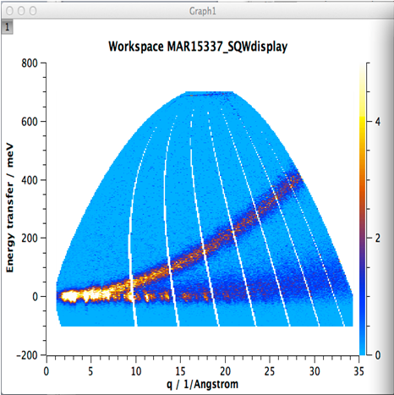
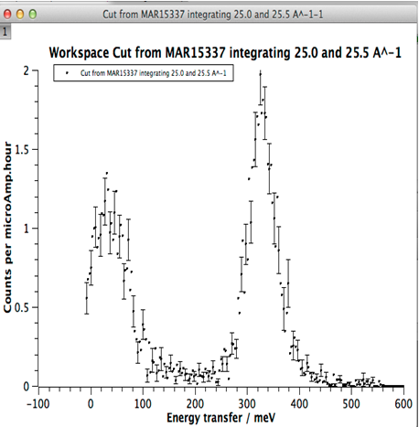
Intelligent Run Control
Define Region of interest
Define error bar criteria
BEGIN Run
Update from DAE & Reduce data to S(q,w)
Calculate statistic for ROI
Does statistic meet criteria
NO
YES
END run

Slide 8
More Future Tasks
Multiple Scattering Corrections
Integration with Third Party simulation codes
McPhase, GULP, Gaussian, CASTEP etc
Simulation first, Optimisation later
Better use of facility / cloud resources
Remote desktop – Performance and stability
Client server Mantid
Web based UI
Parallel visualisation rendering

Slide 9
More Future Tasks
Technique specific training courses
Support for imaging instruments
Further experimental planning tools

